Slide 1

Database & Database Applications
Chapter 5:Relational Database Design ERD-to-Relational Mapping

Slide 2
Outline
Basic Definitions
Design Guidelines for Relation Schemas
Functional Dependencies
Diagrammatic Representation of FDs
Inference Rule (IR)
Reflexive Rule (R.R)
Augmentation Rule (A.R)
Transitive Rule (T.R)
Union Rule (U.R)
Decomposition Rule(D.R)
Pseudo-Transitive Rule (P.R)
Normalization of data
Process of Normalization
First Normal Form (1NF)
Second Normal Form (2NF)
Third Normal Form (3NF)
Boyce-Codd Normal Form (BCNF)
Normal Forms Summary

Slide 3
Basic Definitions
Student(SSN, STNO, Name, Address, Salary)
Superkeys
{SSN,Name}/{SSN,STNO,Name,Address,Salary}
Candidate keys
{SSN, STNO}
Key
SSN or STNO
Prime Attribute
SSN and STNO
Nonprime Attributes
{Name, Address, Salary}

Slide 4
Design Guidelines for Relation Schemas
Guideline#1:
Design Relation schemas so that their attributes will have clear meanings and related attributes are grouped into single entities.
Guideline#2:
Design Relation Schemas in such a way to avoid update anomalies.
Guideline#3:
Avoid (minimize) NULL values.
Guideline#4:
Design schemas so that when relations of such schemas are joined no wrong tuples will be generated.

Slide 5
Guideline#1
Relation Schema must have clear understanding.
Example:
Design I:
STUDENT(STNO, Name, Address, ANO)
ADVISOR(ANO, Name, Address, Dept)
Design II:
Student-Advisor(STNO, Name, Address, ANO, A-name, A-address, Dept)
Design I is better when compared with Design II.

Slide 6
Guideline#2
Avoid Anomalies:
Insertion Anomalies
As you can see, the department information is repeated in the table.
Delete Anomalies
If we delete an employee, we may delete a department (May be the only information we have about it).
If we delete a department, we may delete an employee related to that department
Update Anomalies
If we want to update information regard a deptment (i.e modify department number from 10 to 60) we may go through all the tuples contain the departments number.
EmployNo | EmpName | DeptNo | DeptName
100 | ALI | 10 | CS
110 | Mohammad | 20 | SE
200 | Ahmad | 20 | SE

Slide 7
Guideline#3:
Avoid too much NULL Values.
Problems with Nulls:
Waste storage space.
Have multiple interpretations (not-applicable, not-known,…).
Create ambiguities with aggregate functions (count, avg, …)
Create ambiguities with joins.
To solve Null values, you must make a threshold. Let say if null values is > 70% of the column then an action needed to be taken to solve this issue.
Example:
EmpNo | EmpName | PhoneNo
Suppose Phone number attribute have more that 70% null Values.
EmpNo | EmpName
Empno | phoneNo

Slide 8
Guideline#4:
On Join must produce no wrong tuples.
Example: Suppose we have the following two tables
SSN | Pno | Hours | Pname | Plocatoin
11 | P1 | 20 | X | Irbid
22 | P1 | 20 | X | Ibrid
22 | P2 | 25 | Y | Amman
Ename | Plocation
ALI | Irbid
Mohammad | Irbid
Maha | Amman
After Joining it produce wrong information (Ali have two SSN’s!!!)
Ename | Plocation | SSN | Pno | Hours
ALI | Irbid | 11 | P1 | 20 | X | Irbid
ALI | Irbid | 22 | P1 | 20 | X | Ibrid
Mohammad | Irbid | 11 | P1 | 20 | X | Irbid

Slide 9
Functional Dependencies
Determines the relation of one attribute to another attribute.
Functional dependency helps you to maintain the quality of data in the database.
A functional dependency is denoted by an arrow →.
The functional dependency of X on Y is represented by X → Y.
Functional Dependency plays a vital role to find the difference between good and bad database design.

Slide 10
Diagrammatic Representation of FDs
SSN → STNO, NAME, MAJOR
STNO → SSN, NAME, MAJOR
Student(SSN, STNO, Name, Major)
FD 1
FD 2

Slide 11
Inference Rule (IR)
The Armstrong's axioms are the basic inference rule.
Armstrong's axioms are used to conclude functional dependencies on a relational database.
The inference rule is a type of assertion. It can apply to a set of FD(functional dependency) to derive other FD.
Using the inference rule, we can derive additional functional dependency from the initial set.
The purpose of inference Rule is to find the candidate key, and to do the normalization of a relational schema.

Slide 12
Inference Rule (IR)
Let
F: set of functional dependencies defined on R
F⁺ (Closure of F): is the set of all functional dependencies that can be defined on R
The closure of F is the set of all FDs that are logically implied by F
The closure of F is denoted by F⁺
F⁺ = { X → Y | F ╞ X → Y}
A BIG F⁺ may be derived from a small F
For R(A, B, C) and F = {A → B, B → C}
F⁺ = {A → B, B → C, A → C, A → A, B → B,C → C, AB → AB, AB → A, AB → B, ... }

Slide 13
Inference Rule (I.R)
Reflexive Rule (R.R)
Augmentation Rule (A.R)
Transitive Rule (T.R)
Union Rule (U.R)
Decomposition Rule(D.R)
Pseudo-Transitive Rule (PR)
Note: There are more Rules…

Slide 14
Reflexive Rule (R.R)
You can call it the mirror rule.
Suppose F= {A→B, C→D}
Then by using RR we can say:
A→A,
B→B,
C→C, and
D→D.

Slide 15
Augmentation Rule (A.R)
you can imagine it like incremental way.
Suppose:
X→Y then XZ→YZ.

Slide 16
Transitive Rule (T.R)
You can imagine it like Hoping.
Suppose X→Y and Y→Z Then X-->Z

Slide 17
Union Rule (U.R)
It like an addition Rule
Suppose:
Proof:
1. X → Y (given) 2. X → Z (given) 3. X → XY (using IR₂ on 1 by augmentation with X. Where XX = X) 4. XY → YZ (using IR₂ on 2 by augmentation with Y) 5. X → YZ (using IR₃ on 3 and 4)
X→Y
+
X→Z
_____
X→YZ

Slide 18
Decomposition Rule(D.R)
DR is the opposite of UR
Suppose
X→ YZ
Then,
X→Y
And
X→Z
Proof:
1. X → YZ (given) 2. YZ → Y (using IR₁ Rule) 3. X → Y (using IR₃ on 1 and 2)

Slide 19
Pseudo-Transitive Rule (P.R)
In Pseudo transitive Rule, if X determines Y and YZ determines W, then XZ determines W.
You can call it a substitution rule
If X → Y and YZ → W then XZ → W
Proof:
1. X → Y (given) 2. WY → Z (given) 3. WX → WY (using IR₂ on 1 by augmenting with W) 4. WX → Z (using IR₃ on 3 and 2)

Slide 20
Inference Rule Example
Suppose a relation called R that contain several attributes:
Also, assume that the functional dependencies for this relation are:
F = {O→UD,U→A,A→DT,D→A}
FIND THE F CLOUSER (F⁺ )?
o | U | D | A | T

Slide 21
Normalization of data
Normalization of data considered as testing phase:
First we populate the schema with data (real or fake).
Then, see if it produce anomalies, Or
See if it produce wrong tuples when join.
If any wrong information pop up then we do normalization (decomposition) for the Relations(tables).
We normalize data for several reasons.

Slide 22
Process of Normalization
First Normal Form (1NF)
Second Normal Form (2NF)
Third Normal Form (3NF)
Boyce-Codd Normal Form (BCNF) (a stronger definition of 3NF)
All the above normal forms are based on functional dependencies.

Slide 23
1NF (First Normal Form)
A relation schema R is in 1NF if every attribute of R takes only single and atomic values.
Domains of attributes must include only atomic values and that the value of any attribute in a tuple must be a single value from the domain of that attribute.
In other words, multivalued and composite attributes are disallowed.

Slide 24
Un-Normalized Form (UNF)
1NF Example
ID | Name | Major | Course
20181 | ALI Mohammad | CS | Database
 |  |  | COA
 |  |  | Web Design
20182 | Mohammad ALI | SE | Introduction to SE
 |  |  | Windows Programming
1NF 
ID | Fname | LName | Major | Course
20181 | Mohammad | ALI | CS | Database
20181 | Mohammad | ALI | CS | COA
20181 | Mohammad | ALI | CS | Web Design
20182 | ALI | Mohammad | SE | Introduction to SE
20182 | ALI | Mohammad | SE | Windows Programming

Slide 25
2NF Example
stdNo | CourseNo | Mark | Cname | StdName
FD1
FD2
FD3
As you can see attribute (mark) fully dependent on the keys (stdNo, CourseNo) which is OK 2NF.
Attribute (Cname) is partially dependent on the (stdNo, CourseNo) and that is not OK with 2NF.
Attribute (stdName) is partially dependent on the (stdNo, CourseNo) and that is not OK with 2NF.
So, The Solution …..????!!!!!!!!!!

Slide 26
2NF Solution
Relation1
stdNo | CourseNo | Mark
FD1
Relation2
stdNo | StdName
FD1
Relation2
CourseNo | Cname
FD1

Slide 27
Third Normal Form (3NF)
Rules of 2NF:
Must be in 2NF.
No Transitive dependency.
Empno | Ename | DeptNo | Dname | deptLoc
FD1
FD2
Transitive Here !!!!!

Slide 28
3NF Solution
Empno | Ename
FD1
DeptNo | Dname | deptLoc
FD1

Slide 29
Second Normal Form (2NF)
Rules of 2NF:
Must be in 1NF.
No partial Dependencies
(Y is fully functionally dependent on X if X → Y and no proper subset of X functionally determines Y)

Slide 30
Boyce-Codd Normal Form (BCNF)
Rules of BCNF :
Must be in 3NF.
Attribute is fully dependent on key even if it is a key.
stdNo | Major | Advisor | Gpa
FD1
FD2
How to solve it to meet BCNF…!!!!!!

Slide 31
BCNF Solution
stdNo | Advisor | Gpa
FD1
Advisor | Major
FD1

Slide 32
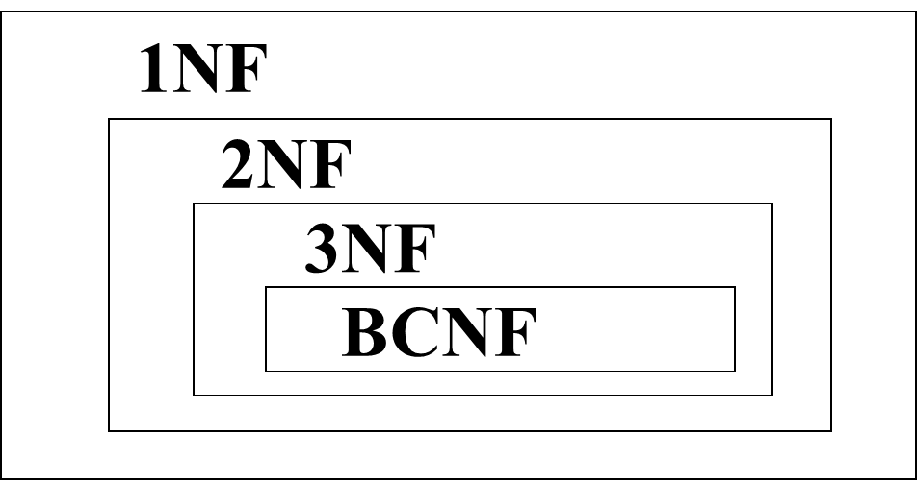
Normal Forms Summary
1NF:
Attributes should be single-valued and have atomic domain
Normalize into 1NF:
Form a new relations for each non-atomic attribute
2NF:
2NF removes some insertion anomalies and deletion anomalies.
2NF removes some redundancies, namely, redundancies caused by partial dependencies on key.
3NF:
3NF removes all insertion anomalies and deletion anomalies.
3NF also removes some redundancies caused by transitive dependencies.
BCNF:
achieves all achieved by 3NF.
BCNF removes all redundancies caused by FDs.

Slide 33
Summary
Describing Important Definitions
Relation Schemas and relational state.
Drawing the Functional Dependencies
Using inference rules to extract the candidate keys
Identifying the Normalization of data
Illustrating of the normalization process (1NF, 2NF, 3NF and BCNF)

Slide 34
THE END

